Slide 1
Extensible Processing
The Spectrum of Archival Intervention
Regine Heberlein, Princeton University
MARAC Fall 2015

Slide 2
What Is Extensible Processing?*
Create baseline level of access to ALL collections
Follow the standards
Create structured data
Process iteratively
Focus on the aggregate
Prioritize policies over items
*Dan Santamaria: Extensible Processing for
Archives and Special Collections.
Chicago: Neal-Schuman 2015
Notes:
I don’t see minimal processing and preservation as opposites, for the simple reason that preservation to me is a part of processing, and processing including preservation occurs at different clearly defined levels.
Background. Worked in MSS division as Processing Archivist. Prior to that, at Mudd Manuscript Library. Trained under Dan Santamaria, whose take on processing has very much informed mine. The term “Extensible Processing” is his from his new book. I used to say Minimal Processing, to get away from the misunderstandings that have come to unfairly burden the term MPLP. Extensible Processing replaces that casual term with one that’s backed up by solid archival theory.
In the MSS division at Princeton, we managed – against institutional culture – to implement a processing program that incorporates these principles. Here is what that has meant for us.

Slide 3
Prerequisite Policies
Mission Statement that Prioritizes Access
Collection Development
Appraisal Guidelines
Processing Guidelines
Environmental Conditions
Notes:
This is what it means to take the Holistic Approach. These need to be implemented on an institutional level; they cannot come from TS alone
Archives are kept to be used. Discard the keeper mentality.
Don’t get crap that you have to keep for political reasons. It’s a waste of money.
Appraisal that’s well implemented happens before the material is on your doorstep.
Preservation is part of processing. Whether minimal processing or whatever.

Slide 4
Processing Principles
The term “processing” encompasses appraisal, description, arrangement, and preservation actions
Processing should occur at a defined level of detail
Appraisal, description, arrangement, and preservation work should occur at a common level of detail
Processing levels should be applied to all collected materials
Processing levels should be applied to aggregates
Processing actions should be applied top-down and iteratively
Notes:
Defined level of detail: allows communication between stakeholders about what actions will be taken. Manages expectations and defines deliverables.
Common level of detail: Greene/Meissner. If the material is so important that it needs item-level preservation attention, then it also needs to be described at the item level. And vv.
All collected materials: digital, objects, audiovisual, whatever. The intellectual work of finding logical groupings and creating evidence-based and actionable description is the same.
Aggregates: important. Once you start cherry-picking, that’s when harm occurs. Destruction of context. This is true not only for preservation tasks but any processing tasks.
Top-down: harm occurs when you go the other way. Destruction of context.

Slide 5
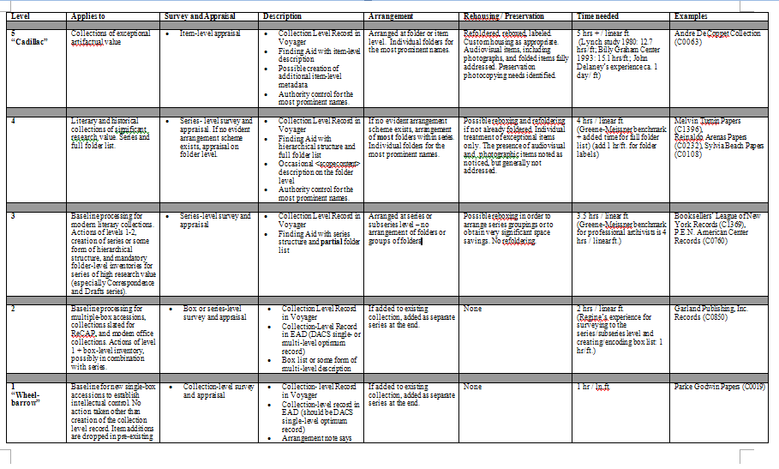
PUL MSS Processing Levels
Notes:
Each level of description inherits the requirements of all previous levels, and adds further requirements.
Economies of scale apply on levels 1-2 only (i.e., processing time per foot will decrease for collections processed to levels 1 or 2)

Slide 6
Manage your Resources
Level | Time needed
5 (“Cadillac”) | 5 hrs + / linear ft. (Lynch study 1980: 12.7 hrs/ft; Billy Graham Center 1993: 15.1 hrs/ft.; John Delaney’s experience ca. 1 day/ ft)
4 | 4 hrs / linear ft. (Greene-Meissner benchmark + added time for full folder list) (add 1 hr/ft. for folder labels)
3 | 3.5 hrs / linear ft. (Greene-Meissner benchmark for professional archivists is 4 hrs / linear ft.)
2 | 2 hrs / linear ft. (Regine’s experience for surveying to the series/subseries level and creating/encoding box list: 1 hr/ft.)
1 (“Wheelbarrow”) | 1 hr / ln.ft.
Notes:
Iterative processing allows you to do what you can do with the resources you have now, and do more later as resources allow
With automation, some of these numbers have gone down. Labels. Still substantial though.

Slide 7
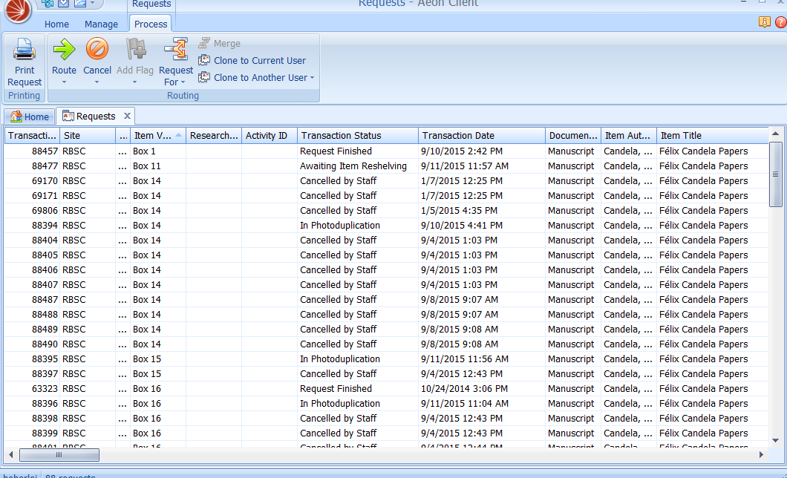
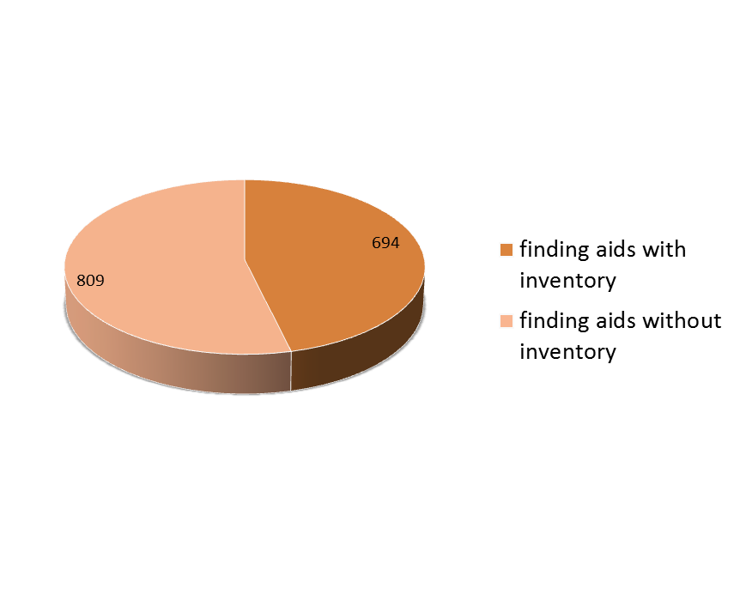
Base Your Actions on Data
Current level of access
Circulation data
Project time needed / staff time available
Notes:
Not anecdotal evidence. Not perceived use of the materials.
~1500 collections in the MSS Division:
all had collection-level EAD’s
809 EAD’s lacked <dsc>

Slide 8
Prioritize Professional over Clerical Work
Appraise
Establish intellectual and physical control
Identify series and logical groupings
Create description in the form of structured and standards-compliant data
Create or support delivery systems that offer user functionality
Notes:
Applying extensible processing is HARDER than engaging in the rote work of removing fasteners and sleeving and sorting.

Slide 9
Forget the Paperclips…
Follow established policies
Maintain stable environmental conditions
Prioritize documented user needs over alleged preservation needs
Preserve & describe at the same level
In case you’re wondering: no, this does not mean abandoning preservation tasks altogether!
Notes:
Preservation is one activity of processing. It needs to be applied with good judgment, along with all the other tasks. That’s a complex interplay of concerns that need to be addressed. Just getting hung up on preservation issues is too narrow a focus. Just streamlining preservation is too narrow a focus.

Slide 10
…and Focus on the Big Picture
Follow the Principle of Sufficiency
Leverage your resources to provide the highest possible level of access to the greatest number of collections
If a machine can do it, make sure it does
Notes:
Don’t overprocess. Don’t overdescribe and don’t overpreserve. Do what needs to be done to provide access. Do what can be done with the resources at hand. Don’t do what a machine can do for you. Don’t do what a non-professional can do for you.

Slide 11
Regine Heberlein
Principal Cataloger and Metadata Analyst,
Rare Book Collections
Princeton University
heberlei@princeton.edu
@allthatdata

